Slide 1
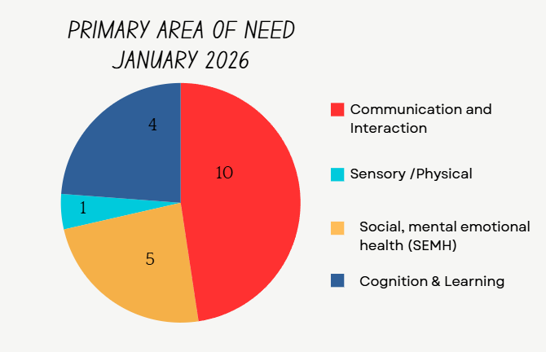

Number of children with SEND by Year group
Year Group > | R | 1 | 2 | 3 | 4 | 5 | 6
SEN Support | 1 | 3 | 1 | 3 | 2 | 3 | 2
EHCP | 0 | 1 | 1 | 1 | 2 | 1 | 3
EHCP in Progress | 0 | 1 | 1 | 0 | 0 | 0 | 0
Notes: 2 EHC requests in progress at the moment with at least 2 further submissions being sent by the end of the academic year. Increased number of children arriving within school who have SEND both in year transfers and new to school. Oldham SEND team have noticed an increase in the number of EHC submissions being sent in for assessment. Speech and Language waiting lists are delaying things for all children in Oldham approx. waiting times are around 2.5 years we have identified a private therapist to provide advice and reports where possible. We follow the graduated response.
Strengths
We ensure that every child feels part of our school. Curriculum is broad and balanced including trips/visitors and wow moments. All SEN pupils access work at their level and are assessed accordingly. High quality teaching is adapted where required. Staff CPD is regularly updated. Regular review meetings with teachers and parents. During these meetings children’s targets updated based on their progress. Use of staff to support our children based on staff expertise. Relationships with outside agencies are strong. Parental relationships are strong.
SEND Totals
EHCP | 9
SEN Support | 12
Attendance 2024-2025
SEND | 90.2%
Non- SEND | 95.1%
Training
LF and AL attend all Oldham SENCo development days. Staff attend required training for speech and language interventions. SEND staff briefing Sept 2025 & further training being completed. SEND Surgeries with QEST advisor booked termly PIVATS assessment training took place in autumn term and further Pivats training where required. Team Teach Training completed for all staff Most staff are trained for ASD Level 1. All staff are Team Teach Trained Precision Teaching Training for all staff – November 2025
Key Priorities for 2025-2026
To embed our parental engagement and continue to implement support sessions for parents. To embed the SEND provision within The Federation including The Haven. For children to be able to access a balanced curriculum using the life skills facilities and sensory spaces now available. To ensure staff are trained in relevant interventions to effectively support the children they work with + trained with the correct interventions/strategies. To monitor the use of PIVATs in assessing children with SEND across the Federation effectively Ensure our children with EHC outcomes are meeting them and making appropriate progress.
How we identify SEND
Class teacher/ parents raise concerns with SENCO using our cause for concern form. (following the graduated response) Discussions and review of what has already been put in place happens. Group interventions to be put in place and then reviewed with parents if required. SEN Support plan and further referrals put in place. Followed by termly reviews with staff, parents, child and outside agencies. Plan do review cycle (PCR)
SEND in a Nutshell
East Crompton St James

